Slide 1
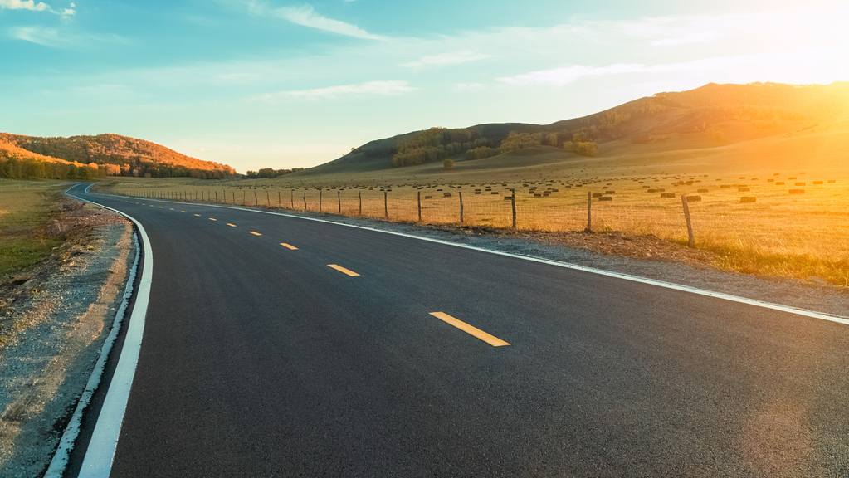
Toronto: Pedestrian accidents
Contributors: Emily R., Tungalagtuya N., George K., & Todd P.
Source: https://open.toronto.ca/dataset/motor-vehicle-collisions-involving-killed-or-seriously-injured-persons/
Data license: https://open.toronto.ca/open-data-license/

Slide 2
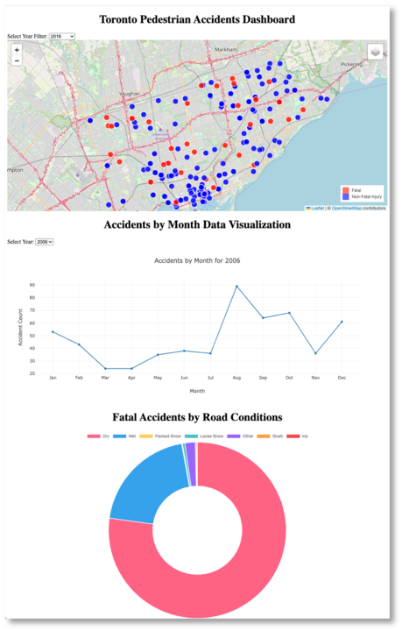

Slide 3

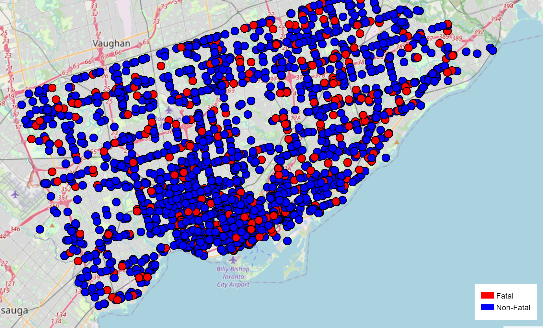
Dataset Overview
Toronto Pedestrian Accident data dashboard
Years 2006-2022
Fatalities and Injuries
Dropdown feature to select an individual year
Showcases the location where an accident occurred
Line chart for the number of accidents per month
Click on event for the following information:
District
Date
Injury
Road Conditions
Data pulled 8/3/2023 Geojson API (CSV has 7355 rows, 57 columns of data)

Slide 4
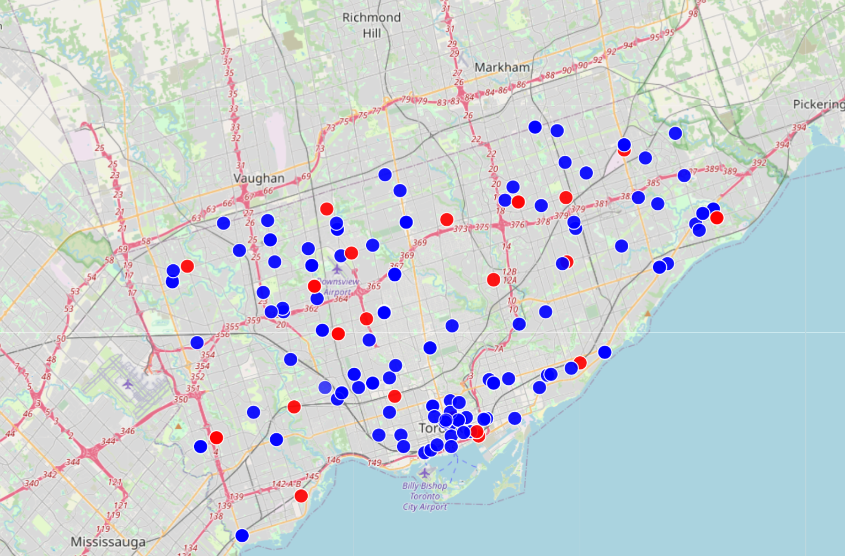
Interactive Map (2006-2022)
Leaflet map with the pedestrian accidents mapped out
Dropdown by Year
Red for Fatal Accidents, Blue for Non-Fatal Accidents
Clusters can be identified for Pedestrian Campaigns, Citizen Meetings and Enforcement for Violations
Changes can be observed over time (variables that impact pedestrian/foot traffic)
Challenges: Having the year dropdown and then being able to reverse the selection
Future Suggestions: Heat Map
All data
2020 Pedestrian Accidents

Slide 5
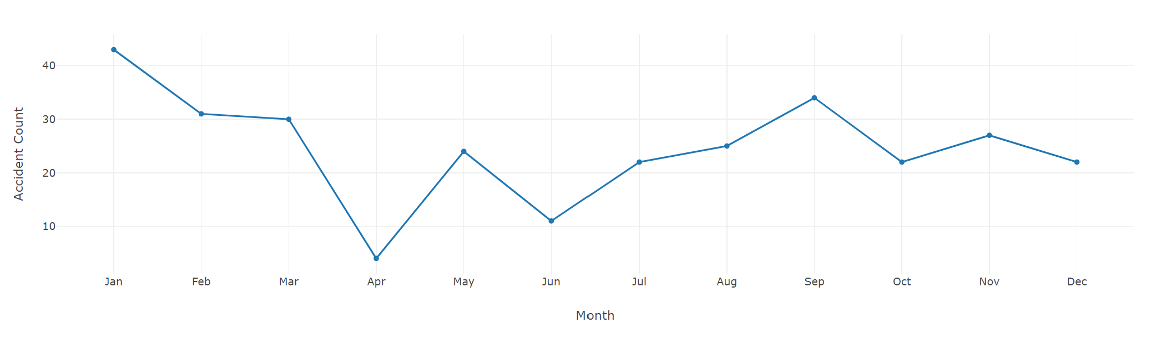
Line Chart(2006-2022)
Plotly Chart with accident counts by Month
Dropdown by Year (2020 is selected above)
Seasonal Changes can be identified or Campaigns can be evaluated
Challenges: Getting the plotly to work with the Leaflet
Future Suggestion: Having one dropdown for all the charts and the map

Slide 6
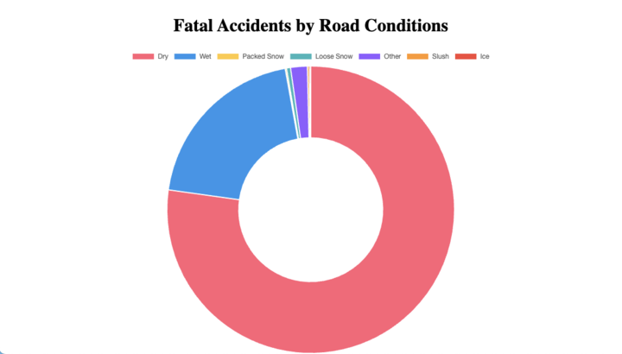
Donut chart overview (2006-2022)
Plotly Chart showing the Fatal Pedestrian Accidents by the Road Surface Conditions
Identify if a certain Road Condition cause more Fatal Pedestrian Accidents
This showed that of the 16 years worth of fatal accidents, more than three quarters of the accidents (77%) were on dry roads
Challenges: Finding Documentation on building donut charts
Future Suggestion: Removing options with 0% of the data (data is present, but insignificant)

Slide 7
Challenges
Finding a dataset
Connecting Flask to MongoDB
Flask and http version of product
GeoJSON URI
Dashboard
Getting all of the pieces to work
Collaboration

